Slide 1
Tech Allies
by Team EF

Slide 2
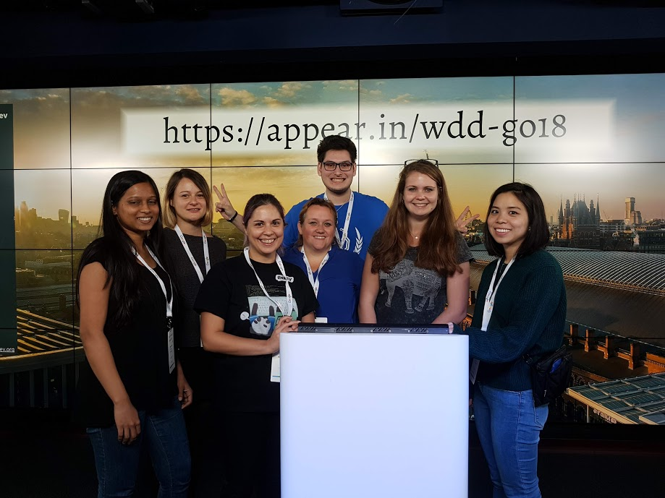
Let’s get cracking!!!
Soooooo…. Who are we ? What do we do ? Where are we from ?

Slide 3
Why Tech Allies ?
We recognised the need of having a support group to go to when it comes to being new in Tech (or a portion of it)
Having a place to go to when things do not go as planned, when you feel left out, when the code just breaks
We have all been through this at some point in our lives (AAAAAHHHHH !!!)

Slide 4
What did we use ?
Our fabulous selves
Background & ideas Fun & excitement
CSS
SASS
React
Node
JavaScript
IntelliJ
VisualStudio
Flask
Python3
JSON

Slide 5
A quick demo
A quick demo
Of course the video does not work in a presentation… What did you expect ?

Slide 6
Thank you for the attention !!!

